Slide 1
From Concrete to Abstract:
Activities to Build Important Math Concepts
Presented by Heather Sparks, NBCT
2009 Oklahoma Teacher of the Year
May 11, 2009

Slide 2
The BIG 5:
1.2 Problem Solving
3.1 Estimation
3.2 Multiplication
3.3 Money
4.2 Measurement

Slide 3
1.2 Problem Solving
Create, extend, and predict patterns

Slide 4
What’s My Rule
n | y
6 | 8
7 | 9
8 | 10
88
 | 2
n | y
10 | 3
80 | 73
240 | 233
56
 | 1
n | y
4 | 7
7 | 13
10 | 19
100
 | 7
n | y
1 | 9
3 | 7
6 | 4
0
 | 10

Slide 5
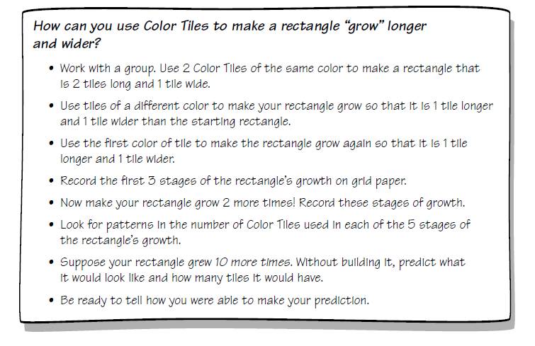
Growing Rectangles

Slide 6
1 x 2
2 x 3

Slide 7
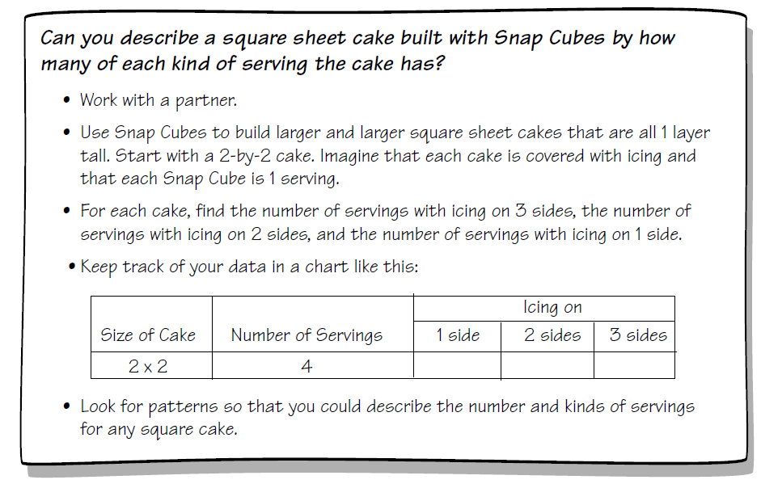
Take the Cake

Slide 8

Two of a Everything
What’s the pattern of Mr. Haktak’s big brass pot?

Slide 9
3.1 Estimation
Estimate, find the sum or difference, with and without regrouping of 3- and 4-digit numbers

Slide 10
Estimation Contest
Estimate how may goldfish crackers are in the jar.
Estimate how much of the large jar will be filled by the same number of goldfish.
Estimate how many goldfish it will take to fill the large jar half way.

Slide 11
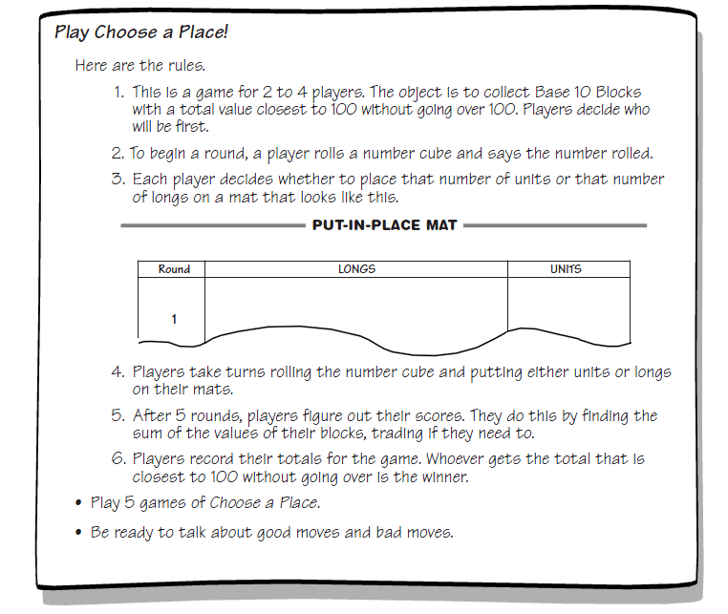
Choose a Place

Slide 12
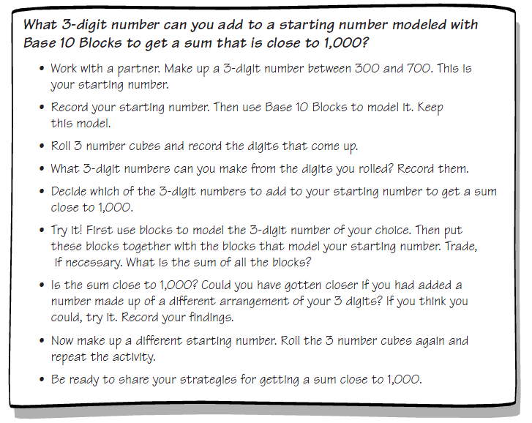
1000 More or Less

Slide 13
Estimation Destination
http://content.scholastic.com/browse/article.jsp?id=2782

Slide 14
3.2 Multiplication
Facts, algorithms, estimate 2-digits by rounding

Slide 15
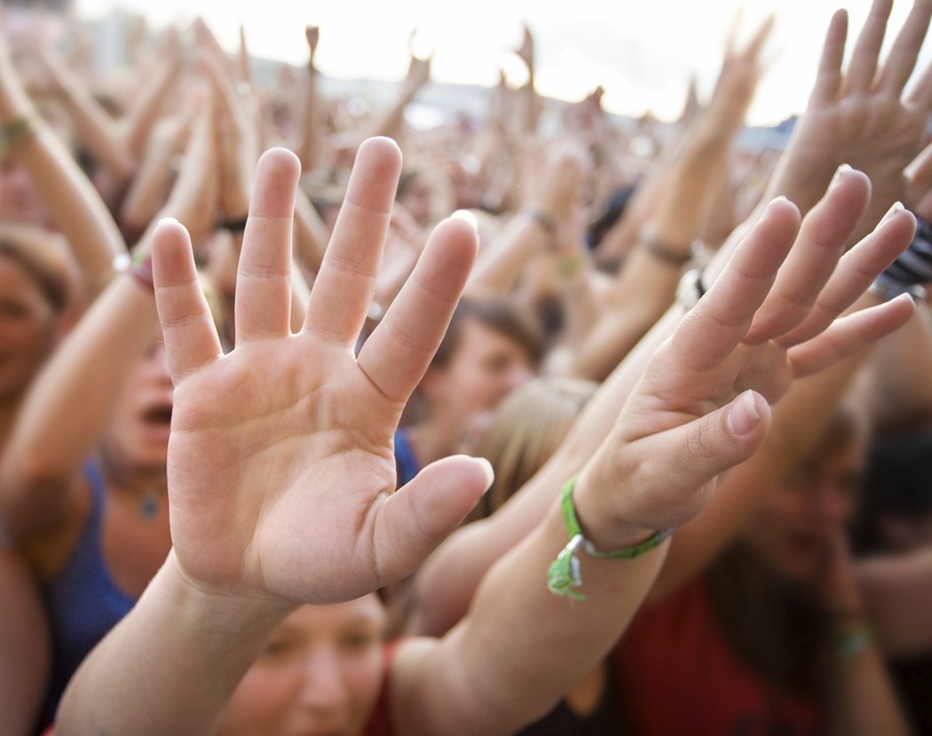
Finger Multiplication

Slide 16
Skip Counting

Slide 17
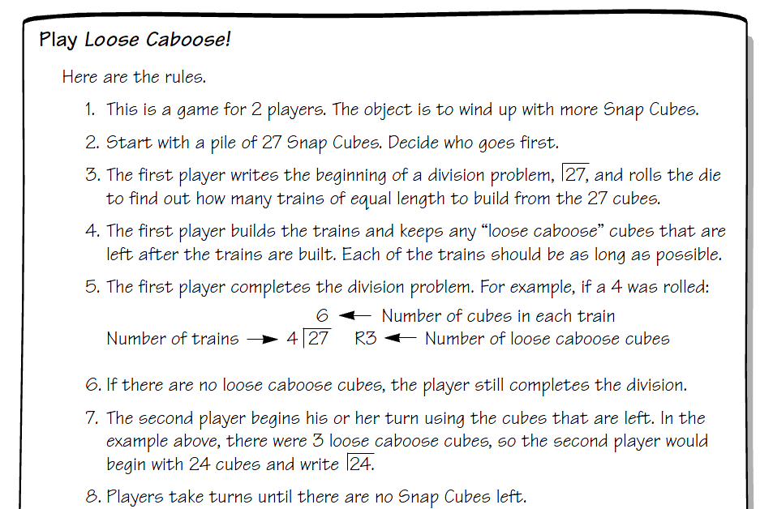
Loose Caboose

Slide 18
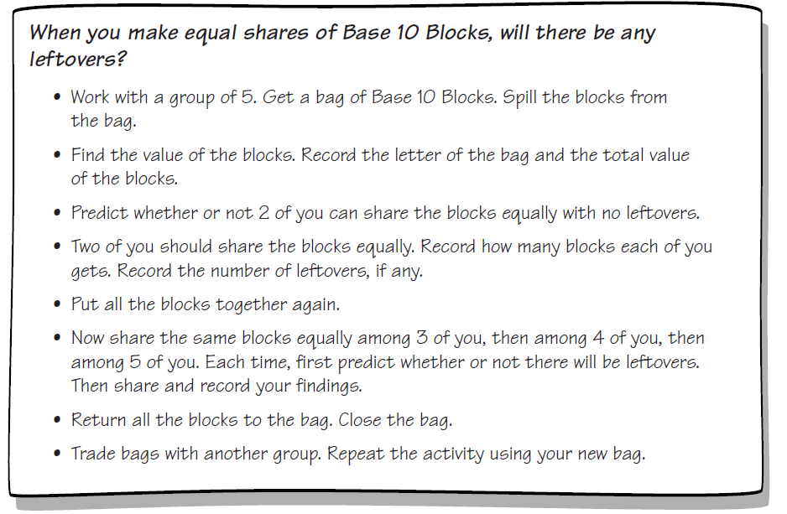
It’s In the Bag

Slide 19
3.3 Money
Solve problems involving money that required addition or subtraction.

Slide 20
How Much Is Your Name Worth?
A= $.01
B= $.02
C= $.03
D= $.04
E= $.05
F= $.06
G= $.07
H= $.08
I = $.09
J= $.10
K= $.11
L= $.12
M= $.13
N= $.14
O= $.15
P= $.16
Q= $.17
R = $.18
S= $.19
T= $.20
U= $.21
V= $.22
W= $.23
X= $.24
Y= $.25
Z= $.26

Slide 21
Counting Change

Slide 22
Candy Store
One ounce of jelly beans costs $.25 . How much would three ounces cost?
One ounce of gummies costs $.21. How much would four ounces cost?

Slide 23
Money Management

Slide 24
4.2 Measurement
Develop and use strategies to estimate measurement

Slide 25
Tall, Wide, and Square
Measure and record your height in inches and the length of your arms (outstretched) in inches.

Slide 26
The BIG Inch
0 1
1
16
1
8
3
16
1
4
5
16
3
8
7
16
1
2
9
16
5
8
11
16
3
4
13
16
7
8
15
16
2
2
2
16
2
8
6
16
2
4
10
16
6
8
14
16
4
4
4
16
4
8
12
16
8
8
8
16
16
16
Identity
Property

Slide 27
Scavenger Hunts
Find an object that measures 3 ¼ inches in length.
Find an object…

