Slide 1
Getting to “It”
Maximizing the “It” Factor
in Your Classroom
Presented by Heather Sparks, NBCT
2009 Oklahoma Teacher of the Year

Slide 2
Introductions
Find one object that represents something important about you.
-Tell us your name
Where and what subject(s) you teach
Explain your object

Slide 3
Class Expectations
What did you hope to get from your time here?

Slide 4
What Make A Great Teacher?
List key traits on sticky-notes…one per note.
Now group your notes
Work your partners to combine your groups

Slide 5
Think of a student…

Slide 6
What is Student Engagement
Student engagement occurs when "students make a psychological investment in learning. They try hard to learn what school offers. They take pride not simply in earning the formal indicators of success (grades), but in understanding the material and incorporating or internalizing it in their lives."[
-Student Engagement and Achievement in American Secondary Schools. Teacher College Press, p. 2-3.

Slide 7
Think of a time when you were engaged in school.
Describe your experience to someone sitting next to you.

Slide 8
Some Facts About
Student Engagement
Over one-third of students do not take school seriously and get through the day by fooling around with classmates.
Half said their classes were boring.
Two-thirds say they cheated on a test.
90% copied homework from someone else.
80% say it’s not important to get good grades in school.
20% say disengagement is a result of confusion or difficulty of subject matter, particularly in math and science.
(Steinberg, 1996)

Slide 9
What can be done?
Ames, Strong, et. al., and Anderman and Midgely, show that teachers who are most successful in engaging students develop activities that address intellectual and psychological needs including work that:
  Develops their sense of competency;
  Encourages self-expression and originality;
  Allows them to develop connections with other; and
  Gives them some degree of autonomy.

Slide 10
Human Motivation
Daniel Pink Video

Slide 11
Let’s Consider…
A Student: A Learner
  Passive
  Bored
  Told what to think
  Typically unmotivated
  Focused on the grade
  Active
  Engaged
  An independent thinker
  Internally motivated
  Focused on the learning

Slide 13



Teaching is always evolving and improving.
Pod-casting
voiceThread
Museum Box

Slide 14
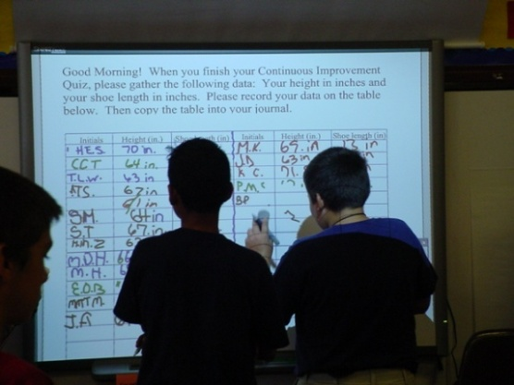
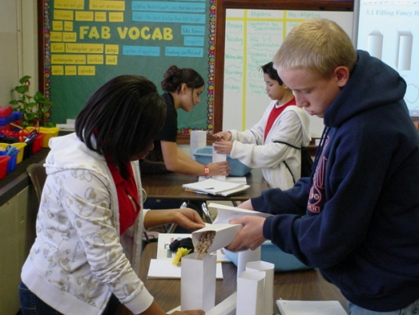
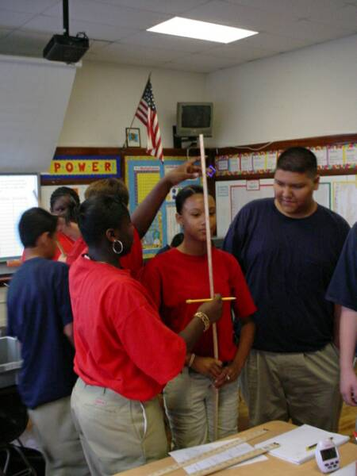
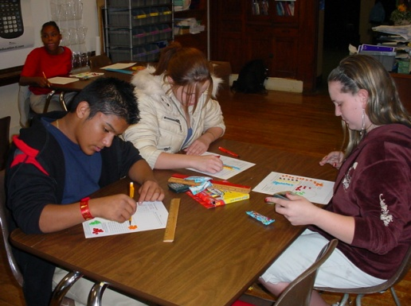
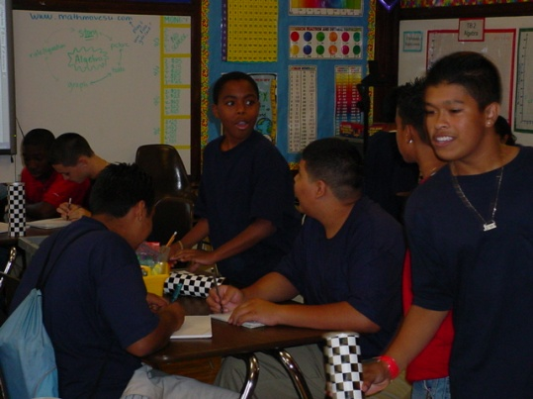
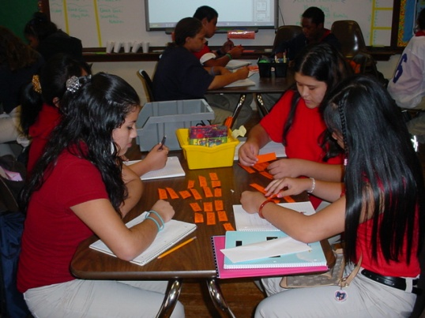
What does this look like?
The “Ultimate” Apartment Project
“Me”suems
A Pioneer’s Diary
Kindergarten Pod-casts
Veterans’ Project

Slide 15
Strategies for Developing an Engaging Curriculum
Ensure course materials relate to students' lives and highlight ways learning can be applied in real-life situations.
Allow students to have some degree of control over learning.
Assign challenging but achievable tasks for all students, including at-risk, remedial, and learning disabled students.
Design projects that allow students to share new knowledge with others.

Slide 16
Three “Musts” of Motivation
The work must provide:
AUTONOMY …Desire to be self-directed
MASTERY …The urge to get better at something
PURPOSE …Making a contribution

Slide 17
For a Copy of this Presentation, visit Heather’s Website:
www.hisparks.com
Click on presentations.

