Slide 1
Classroom Management
“I CAN DO IT!”
Presented by Heather Sparks, NBCT
Taft Middle School, Oklahoma City
And Bonnie Hammock, OEA
Notes:
Introduction of presenters

Slide 2
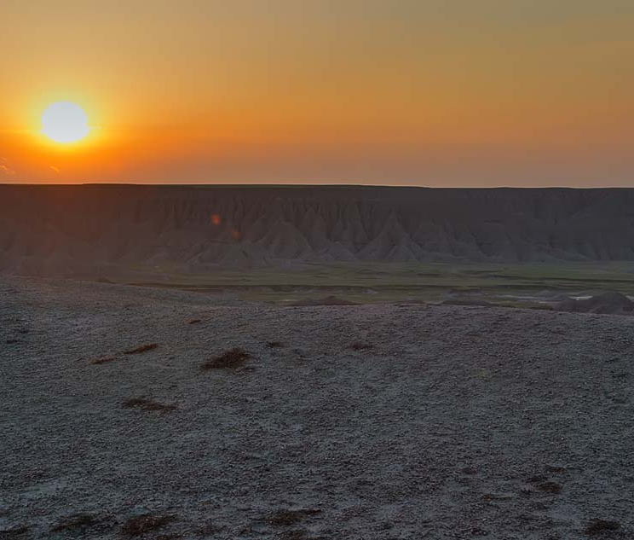
Section 1
Training Goals

Slide 3
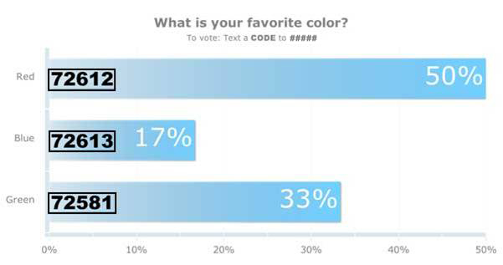
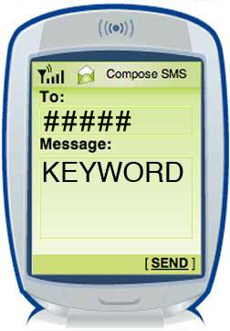
How To Vote via Texting
EXAMPLE
Standard texting rates only (worst case US $0.20)
We have no access to your phone number
Capitalization doesn’t matter, but spaces and spelling do
TIPS
Notes:
This slide is for display to the audience to show them how they will vote on your polls in your presentation. You can remove this slide if you like or if the audience is already comfortable with texting and/or voting with Poll Everywhere.
Sample Oral Instructions:
Ladies and gentlemen, throughout today’s meeting we’re going to engage in some audience polling to find out what you’re thinking, what you’re up to and what you know. Now I’m going to ask for your opinion. We’re going to use your phones to do some audience voting just like on American Idol.
So please take out your cell phones, but remember to leave them on silent. You can participate by sending a text message.
This is a just standard rate text message, so it may be free for you, or up to twenty cents on some carriers if you do not have a text messaging plan. The service we are using is serious about privacy. I cannot see your phone numbers, and you’ll never receive follow-up text messages outside this presentation. There’s only one thing worse than email spam – and that’s text message spam because you have to pay to receive it!

Slide 4
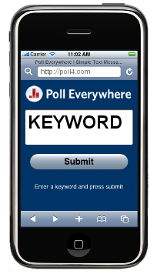
How To Vote via Poll4.com
EXAMPLE
TIP
Capitalization doesn’t matter, but spaces and spelling do
Notes:
This slide is for display to the audience to show them how they will vote on your polls in your presentation. You can remove this slide if you like or if the audience is already comfortable with texting and/or voting with Poll Everywhere.
Sample Oral Instructions:
Ladies and gentlemen, throughout today’s meeting we’re going to engage in some audience polling to find out what you’re thinking, what you’re up to and what you know. Now I’m going to ask for your opinion. We’re going to use your phones or laptops to do some audience voting just like on American Idol.
So please take out your mobilephones or laptops, but remember to leave them on silent. You can participate by submitting an answer at Poll4.com on your laptop or a mobile phone.
The service we are using is serious about privacy. I cannot see who you are or who voted.

Slide 5
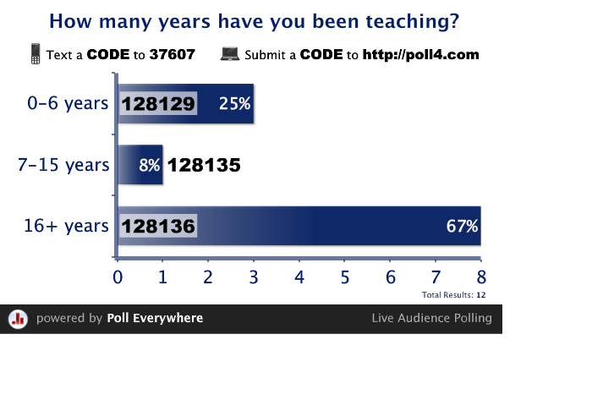
Don’t forget: You can copy-paste this slide into other presentations, and move or resize the poll.
Poll: How many years have you been teaching?
Notes:
Poll: How many years have you been teaching?
Press F5 or use the tool bar to enter presentation mode in order to see the poll.
In an emergency during your presentation, if the poll isn't showing, navigate to this link in your web browser:
http://www.polleverywhere.com/multiple_choice_polls/LTk3MzgzMjA5OQ
If you like, you can use this slide as a template for your own voting slides. You might use a slide like this if you feel your audience would benefit from the picture showing a text message on a phone.
5

Slide 6
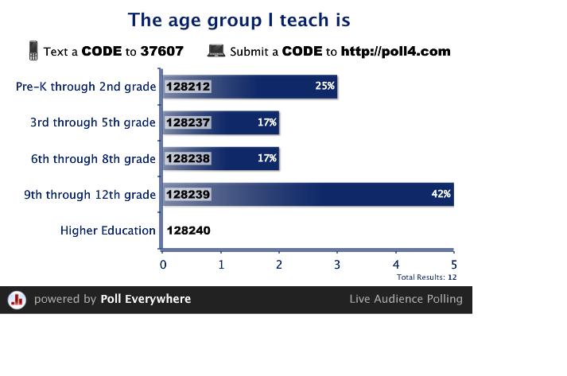
Don’t forget: You can copy-paste this slide into other presentations, and move or resize the poll.
Poll: The age group I teach is
Notes:
Poll: The age group I teach is
Press F5 or use the tool bar to enter presentation mode in order to see the poll.
In an emergency during your presentation, if the poll isn't showing, navigate to this link in your web browser:
http://www.polleverywhere.com/multiple_choice_polls/NTMyMzE3NjQw
If you like, you can use this slide as a template for your own voting slides. You might use a slide like this if you feel your audience would benefit from the picture showing a text message on a phone.
6

Slide 7
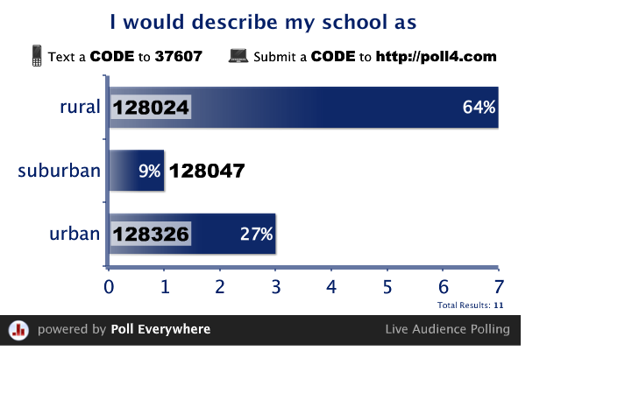
Don’t forget: You can copy-paste this slide into other presentations, and move or resize the poll.
Poll: I would describe my school as
Notes:
Poll: I would describe my school as
Press F5 or use the tool bar to enter presentation mode in order to see the poll.
In an emergency during your presentation, if the poll isn't showing, navigate to this link in your web browser:
http://www.polleverywhere.com/multiple_choice_polls/LTIxNDMwMzc3NzI
If you like, you can use this slide as a template for your own voting slides. You might use a slide like this if you feel your audience would benefit from the picture showing a text message on a phone.
7

Slide 8
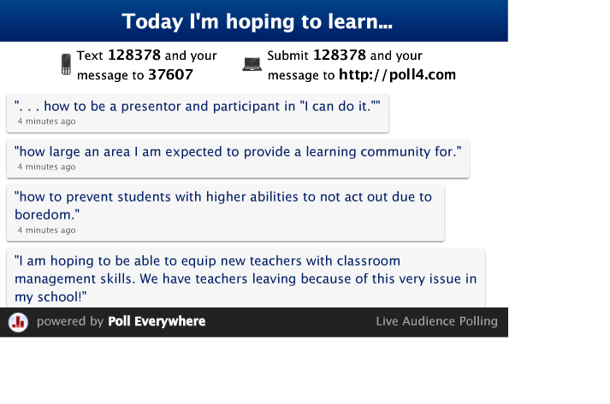
Don’t forget: You can copy-paste this slide into other presentations, and move or resize the poll.
Poll: Today I'm hoping to learn...
Notes:
Poll: Today I'm hoping to learn...
Press F5 or use the tool bar to enter presentation mode in order to see the poll.
In an emergency during your presentation, if the poll isn't showing, navigate to this link in your web browser:
http://www.polleverywhere.com/free_text_polls/LTEyNzYwOTU0NTI
If you like, you can use this slide as a template for your own voting slides. You might use a slide like this if you feel your audience would benefit from the picture showing a text message on a phone.
8

Slide 9
KWL Chart: Classroom Management
What I Know
What I Want to Know
What I Learned
Notes:
Before beginning KWL chart have participants introduce themselves.
KWL Activity:
Materials
Charts and sticky notes

Slide 10
Our goals…let’s talk about:
Creating Learning Communities
Student/Parent/Teacher Relationships
Establishing Rules & Routines
Collaboration & Partnering
Motivation and Rewards
Dealing with Conflict
Notes:
-explore useful paths to successful classroom management
-techniques used by successful teachers

Slide 11
Two primary objectives of classroom management:
Ensuring the SAFETY of students & staff
Allowing LEARNING to take place
Notes:
-reminder: safety is both physical and psychological
How can we achieve this climate in the classroom?

Slide 12
How do we achieve this in the classroom?
First,
Create Community
Notes:
-familiarity and knowledge of one another are the first steps toward a supportive community

Slide 13

Section 2
Getting to Know Your Students
Notes:
-all kinds of activities and interest inventories that can allow you and your students to get to know each other in safe and positive ways
-got to know you using snazzy Poll Everywhere questions
-Birthday Probability Pairs activity (get up, form a circle around tables in order of month and day of their birthday without speaking: after activity reveal that for every 26 participants, there is a 50% probability that 2 people will share the same birth date, month and day (if no matches within the group, add info about family members will produce a match)
-Other ideas: name ball games, adjective with name, me collages or quilts

Slide 14

Images of Community
Notes:
Quilt activity
Materials:
Paper, tape, markers
Divide your quilt block into 4 squares: (10 min)
-name
-icon
-quality of strength
-image
2. Figure out as a group how to put it together (5 min)

Slide 15
Reflection
Discuss what this may look like in your own classroom?
How can this activity be used in other ways?
Notes:
Quilt Activity: image of community – sense of diversity, but with stitching that binds us together to create a blanket of warmth
Other ways to build community: sit and eat lunch with students; ask about their family; mini conferences during recess or transition times

Slide 16
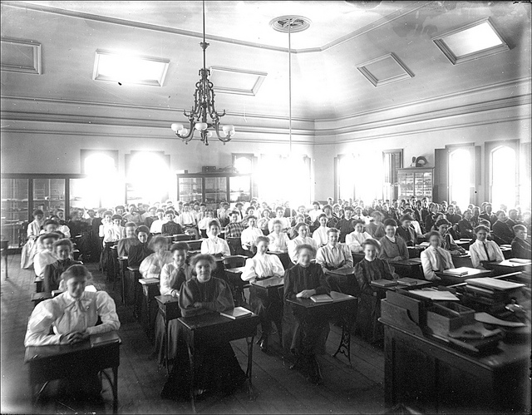
Creating a community in your classroom so that…
Students feel valued and respected
They have a role in decision making
Students connect to others in a healthy way
They feel safe to take risks
Notes:
Video clip for respected-school tube: Being a Culturally Responsible…
Video clip for healthy-school tube: Teachers Perspective

Slide 17
The Anti-Bullying Classroom
    • Make eye contact with each student
    • Call all students by their first or preferred name
    Move toward and stay close to the learners
    Collaborative problem solving of classroom issues
    With-it-ness
Notes:
Connect the anti bullying policy implemented by the state to promote community while decreasing incidents of bullying behavior. Creating a classroom of acceptance begins with the teacher as the role model. Connect back to video on respect. Ignoring is not a form of tolerance- WE want to foster acceptance and appreciation of one’s differences.
Two Elements to create positive learning environment: comfort and order
Comfort – physical comfort
Order – identifiable routines and guidelines/expectations for acceptable behavior

Slide 18
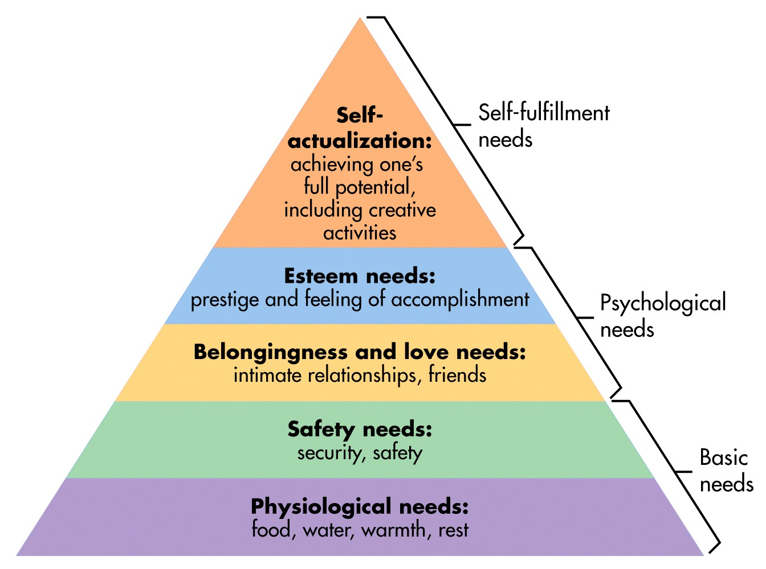
Remember Maslow?
Notes:
-what’s old is new
-refers back to 2 main objectives of classroom management: Ensuring the SAFETY of students and staff; Allowing LEARNING to take place

Slide 19
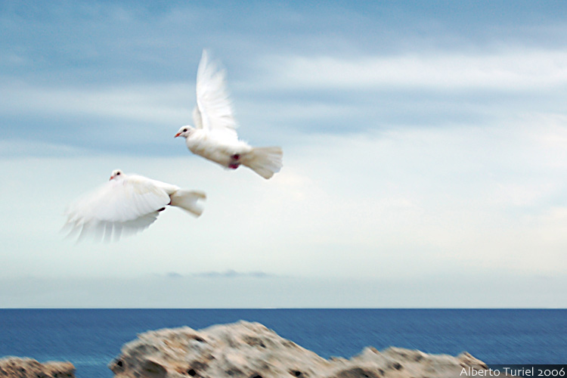
    Come To The
    Come to the Edge
    Come to the edge.
    It's too tall.
    Come to the edge.
    I'll fall.
    Come to the edge.
    And they came.
    And you pushed them.
And they flew.
Notes:
Pick reluctant participant to read.

Slide 20
Enhancing acceptance:
Comfort and Order
Room Temperature
Furniture Arrangement
Physical Activity
Breaks
Bulletin Boards (Walls)
Climate (Humor and Tone)
Routines
Guidelines
Class Agreements (class sets rules)
Notes:
Discuss slide. Refer to pages 11-20 in the manual for suggestions.
Ball activity
Break after this activity to set up for True Colors

Slide 21

Section 3
Communication Styles

Slide 22
What is your
COMMUNICATION STYLE?
TRUE COLORS

Slide 23
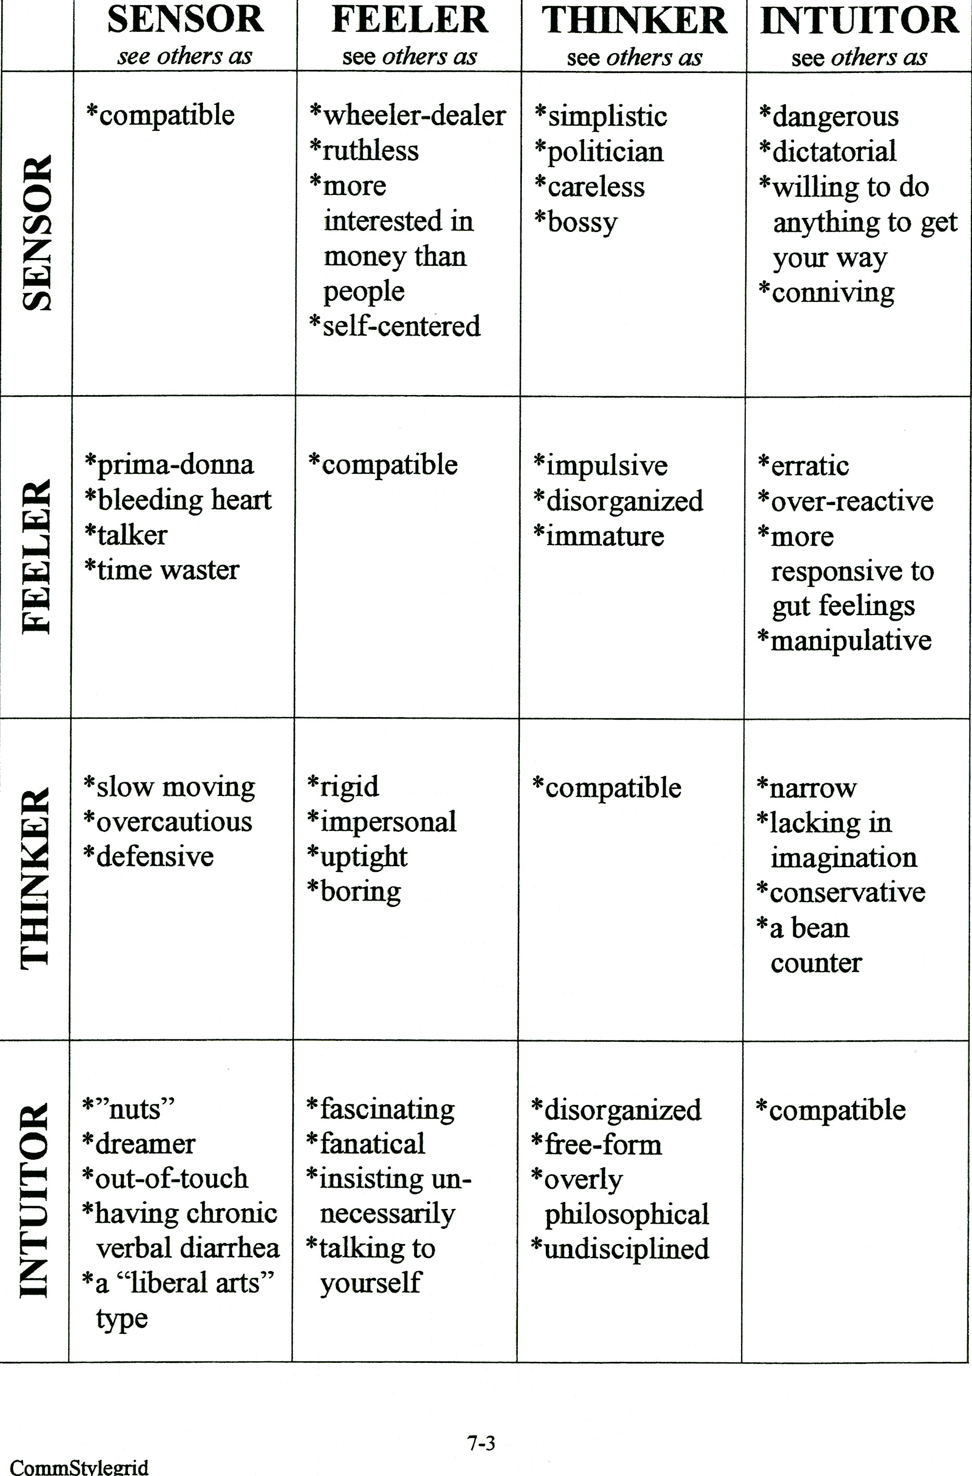

Slide 24
Ticket Out the Door
Record your responses to the following statements regarding classroom management:
I dream…
My worst nightmare…
I will…
Notes:
Have participants place each response on stickies to the appropriately labeled charts on their way out the door for lunch.

Slide 25
Home/School Communication
Utilize a Back to School letter with parental contact information request
Keep a contact log
Use email whenever possible (this helps create a paper trail)
Strive for 2-way communication; NBPTS requires it!
Notes:
Utilize your districts gradebook program…most have “notes” windows where you can record contacts. Emphasize to participants to follow district policy regarding guidelines pertaining to parent contact.

Slide 26
Instructional
Program
Individual
Students
Home & School
Communication
Engaging
Families
Notes:
-parents are critical partners in student’s education

Slide 27

Section 4
Rewards and Motivation

Slide 28

Puzzle Activity
Notes:
Directions:
Wait to open your envelopes until I say “You may begin.”
Work at your table to solve the puzzle inside your envelope.
***note to self: two tables: 1st one finished at your table gets a prize
two tables: go tell them they are doing a good job working
two tables: whole table as a team gets a prize
Problem: Anne has three blouses, four skirts, and two pairs of shoes. How many different outfits can she wear if an outfit consists of any blouse worn with any skirt and either pair of shoes?
Door prize for winner at tables with first finish: Bags
Door prize for group winner: Candy

Slide 29

Intrinsic vs. Extrinsic Motivation
If you punish a child for being naughty and reward him for being good, he will do right merely for the sake of the reward, and when he goes out into the world and finds that goodness is not always rewarded, nor wickedness always punished, he will grow into a man who thinks about how he may get on in the world, and does right or wrong according as he finds of advantage to himself.
Immanuel Kant, Education
Notes:
Debrief Puzzle Activity: How did knowledge of prizes as a team vs individual affect your performance?

Slide 30

The truth of the matter…
“Rewards can deliver a short-term boost – just as a jolt of caffeine can keep you cranking for a few more hours. But the effect wears off – and, worse, can reduce a person’s longer-term motivation to continue the project.”
Notes:
18 minute video: Daniel Pink
Mastery – the desire to get better and better at something that matters
Autonomy – the urge to direct our own lives
Purpose – the yearning to do what we do in the service of something larger than ourselves
“Traditional notions of management are great if you want compliance. But if you want engagement, self-direction works better.”

Slide 31

Selecting the appropriate motivators…consider:
Asking the child
Observing the child’s motives & behavior
Using what has worked in other situations with similar students
Giving students a choice of motivators
What are you rewarding?
Problem-solving or routine (if-thens)
Notes:
-Motivators can be used to increase student’s positive behaviors. The emphasis on rewards/reinforcement needs to be why are we doing this?
Asking the child is a student driven reward. When giving students choices, it is a teacher driven reward.

Slide 32
Give one, Get one!
Write down ONE motivation strategy you find successful
Find a partner & give one NEW idea & get one NEW idea (write it down…)
Move to another partner & repeat as long as the music continues
If neither of you have a new idea, CREATE one!
Notes:
***exchange no more than one idea with any given partner
Look on page 26 in manual
Verbal Praise
Physical Contact
Tokens
Individual Activities

Slide 33
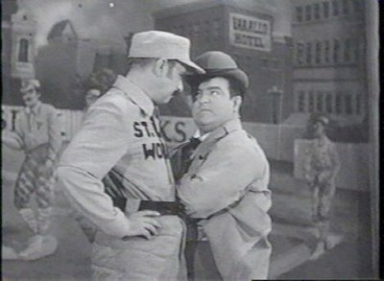
Section 5
Rules and Routines
Notes:
What is teaching? It is practice in theater? How are you managing your “theatre?” Rules and routines connect to practice in teaching. But if you’re not reflecting, your never aware of your effective practice.

Slide 34
Rules & Routines must be taught
Rules: Expected behaviors “Expectations”
Routines: Daily procedures and processes that need to be taught and rehearsed in order to provide smooth, uninterrupted class operation
Remember…GO SLOW TO GO FAST
Notes:
In 13 years of schooling, students learn 30-40 different sets of rules/routines from Pre-K through 12th grade.
Clearly defining and teaching our own expectations and procedures, increases the chance that students will follow expectations. Consider streamlining discipline policies of grade levels, buildings, etc.
With lack of expectations/routines or poorly enforced, result is definite negative impact on the amount of student learning and increased stress for teacher.

Slide 35

Keeping the peace…
VOICE
+
CHOICE
=
LOYALTY!
Notes:
When people have the opportunity to express their opinions or choose, they are more apt to support the decision.

Slide 36
Let’s talk about….
How do you
establish classroom rules or expectations?
What are your
most important rules?
Notes:
Animoto-Lead group into designing own 30 second video of their classroom rules.
Mrs. Jenkins classroom rules and Mrs. Hau’s Requests.
Moving from a thought process of rules implying they are made to be broken. You did it to me, I’ll do it to you mentality only creates defiant behavior. (Mention why?)

Slide 37

Mrs. McCollum’s Expectations
Notes:
Animoto: Great Expectations School – use the Great 8

Slide 38
Routines—establish & practice a clear procedure for:
Passing papers
Leaving for restroom
Sharpening pencils
Heading papers
Getting supplies & books
Working in small groups
Whole class discussions
Tardies
Lunch count/line/room
Passing periods
Class signals
Center Group Rotations
Dismissing class/before bell
Where to put complete work
What to do if done early
Putting away materials
Safety routines/drills
During attendance
How to start the day/bell ringers
Playground
Assemblies
Lining Up
Notes:
20-30 minute table talk activity:
Participant with least experience chooses 3 from the slide and each table presents a framework of ideas/solutions for 1 of their challenges.

Slide 39

    Make it a rule of life
    never to look back.
    Regret is an appalling waste of energy; you can’t build it; it’s only good for wallowing in.
      Katherine Mansfield, Writer
      (1888-1923)
Notes:
You will make mistakes. It’s okay, move on.

Slide 40
Provide CLEAR FEEDBACK ASAP:
Do it:
QUIETY
CALMLY
PRIVATELY
Every time you can!
Notes:
-when routines are interupted, provide feedback
-make sure student understands why the behavior is inappropriate by giving clear feedback

Slide 41

Because the goals for intervention should always be…
EM3
        Eliminate
        Maintain
        Minimize
        Momentum-ize
Notes:
3 goals:
Eliminate, or, at least minimized the unacceptable behavior
Maintain the self esteem of the student
Maintain the momentum of the lesson/activity

Slide 42
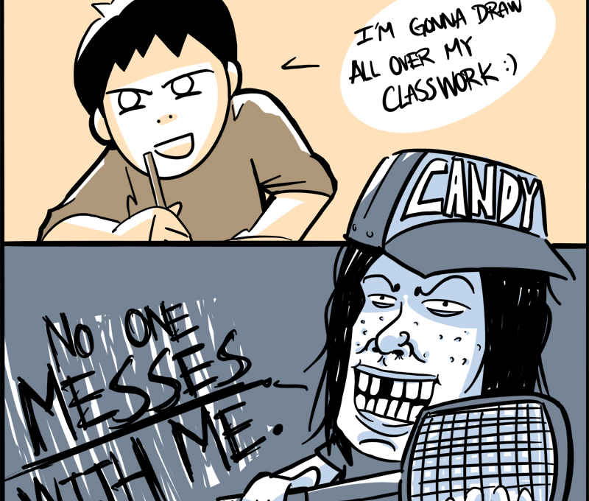
Section 6
Smoothly Flowing
Classrooms

Slide 43
Hints & Tips:
Use signals…consistently
Directions…plan them ahead of time:
  Use 3 step directions before an activity
  Get the attention/feedback of students
  Tell them and show them
  Use signals for whole class response
Thumbs up = yes Thumbs down = no Fist = ? or I don't know

Slide 44
Transitions…
Transition times are controlled through mini-activities
Must be TAUGHT
Creates momentum
Remember…go slow to go fast!
Notes:
Must be TAUGHT explain what you expect & how you expect students to accomplish it, and then DO IT THAT WAY EVERY TIME!
Not only does this create comfort, but it also creates momentum…students know what is coming next & begin getting ready for it seemingly without instructions
Remember…go slow to go fast!

Slide 45
Transition problems…table talk:
Teacher/students distractions during transitions which delay the rest of the class
Students socialization before, during, and after transitions
Students stop/start working habits during the transition of activity or class period
Students don’t pay attention to directions during a transition
Notes:
Examples may include:
Slow students during transitions, looking for materials, finishing attendance, collecting papers, chatting with students
Students talking loudly at beginning of class or after an assignment has been given before beginning work or interrupting teacher
Stop working before end of period, keep working on previous activity during next transition

Slide 46
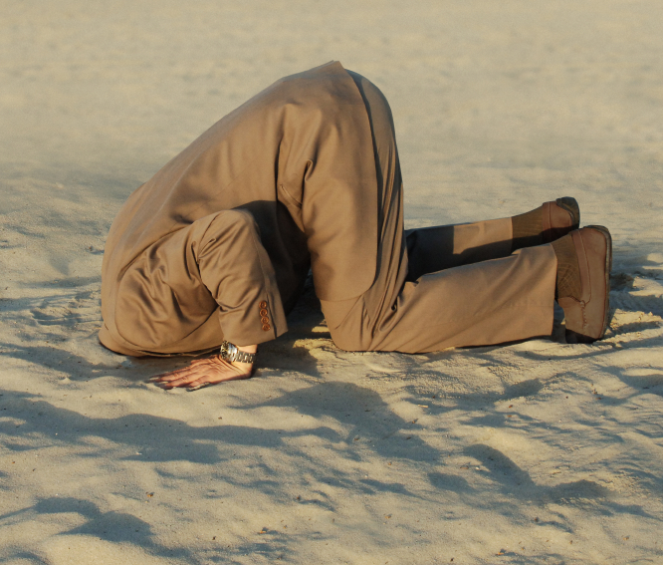
Section 7
Dealing with Conflict

Slide 47
Steps to conflict resolution:
Identify the problem from each person
Listen to the answers.
Identify the cause of conflict
Brainstorm solutions together to find a win-win answer.
Create an “If…then…” solution statement

Slide 48
Reflection
Reflect upon a situation with a hostile or defiant child you wished you had handled differently. Which of these strategies might have proven useful to both you and the child?
Notes:
If this doesn’t come up as an issue, use this as a reflection.
-try shaping behavior by celebrating successive small steps toward a goal
-consistent implementation of strategy involving both parent and teacher
-anticipating potential triggers
-carefully planning experiences to maximize success and minimize failure and frustration
Also base this on time issues

Slide 49
Is this behavior an isolated event or a recurring symptom of a greater problem?
Recurring behaviors may indicate :
Low self-concept
Low motivation
Visual perception/memory problems
Receptive language problems
Expressive language problems
Auditory Perception/Memory problems
Attention, Avoidance, Power
Notes:
Have participants read bullets and allow reflection/discussion.
Are they seeking attention in a negative manner? Or are they avoiding a problem? Or is the behavior a power play to push the boundaries of classroom expectations?
Simplify or make into two slides?

Slide 50
Is this behavior an isolated event or a recurring symptom of a greater problem?
OR a more serious problem, such as:
Lack of sleep, food, supervision
Abuse or neglect
Homelessness
Depression, mental illness
Physical illness
Attention, Avoidance, Power
Notes:
Remember Maslows Hierarchy of Needs?

Slide 51
Because the goals for intervention should always be…
EM3
        Eliminate
        Maintain
        Minimize
        Momentum-ize

Slide 52
KWL Chart
What I Know
What I Want to Know
What I Learned
Notes:
Revisit KWL chart and finish with What you Learned (L) as a group share out. Where could we move these post it notes from one column to the next?

Slide 53
Phases of Teacher’s
Attitudes Towards Teaching
Anticipation
Anticipation
Survival
Reflection
Rejuvenation
Disillusionment
Aug Sept Oct Nov Dec Jan Feb Mar Apr May June July
Source: Trainer’s Manual, Support Provider Training, Revised May 1996

Slide 54
Thank you…
For your time, energy, and participation!
This training was adapted from NEA’s/OEA’s/CTA’s
“I Can Do It! Classroom Management Training” & OEA’s “Bullying Prevention Training”
To contact me: hisparks@aol.com
                www.hisparks.com
Notes:
Insert your personal information as contact:

