Slide 1
Improving Access to Mathematics:
Strategies for Elementary
Presented by
Heather Sparks, NBCT
2009 Oklahoma Teacher of the Year

Slide 2
What makes math difficult?
Lack of prior knowledge
Missing foundational skills
Limited experiences with “doing” math
“One right answer” approach
“Permission” to be “bad” at math
Others?

Slide 3
STRATEGIES:
1. Constant exposure to meaningful math
Every day, provide meaningful math investigations
through manipulatives, games, puzzles, and stories.
Content example: Close to 100
Number Lines
Two of Everything

Slide 4
Close to 100
For two players.
Decide who will go first. Roll the die.
Decide if you would like to multiply the number by 10 or 1.
Record your score and give the die to your partner for a turn.
Repeat for five rounds. (You must take all five turns.)
The player whose score is closest to 100 after five turns wins.

Slide 5
Can you fill in the missing numbers on the number line?
4
5
1
2

Slide 6
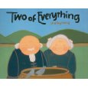
Two of a Everything
What’s the pattern of Mr. Haktak’s big brass pot?

Slide 7
STRATEGIES:
2. Allow students to verbalize their thinking
Every day, expect students to explain their
thinking.
Content example: Take the Cake
Sense & Nonsense

Slide 8
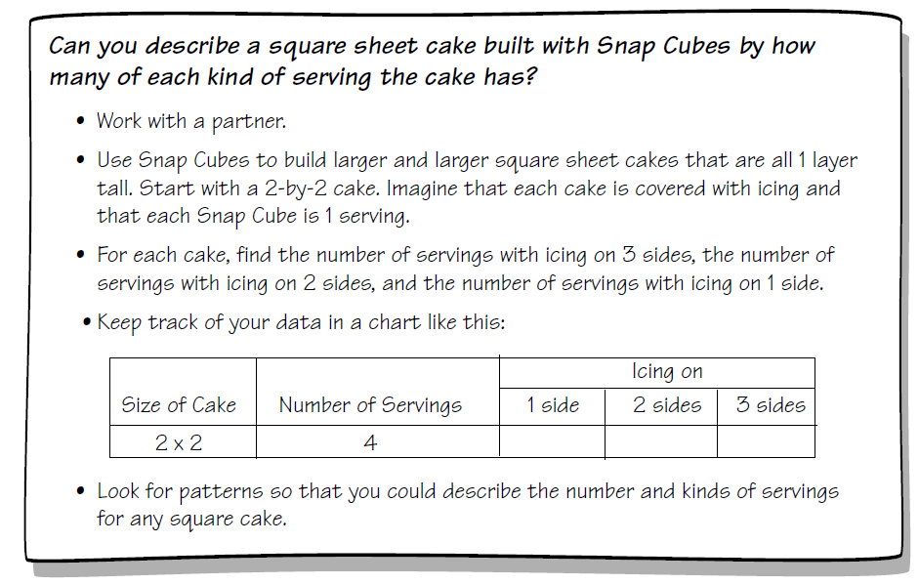
Take the Cake

Slide 9
Sense & Nonsense
Mr. Bragg says he’s right 100% of the time. Is he bragging? Why?
The Garcia family ate out last Saturday. The bill was $46.
Would a 50% tip be too much to leave? Why?
Ellen loaned Me’Shell one dollar. She said the interest would be
75% a day. Is this a pretty good deal for Ellen? Why?
Daniel missed 10 problems on his science test. Do you think his
percentage is high enough for an A? Why?
Rose has a paper route. She gets to keep 25% of whatever money
she collects. Do you think this is a good deal? Why?

Slide 10
STRATEGIES:
3. Provide for meaningful use of manipulatives
Manipulatives should be available and integrated
into every math lesson.
Content example: Farmer Brown
Loose Caboose

Slide 11
Farmer John
Before planting the Spring crops, Farmer John needs to determine
how many acres will be allocated for his vegetables. He decides to
plant 5% of the area with onions, 20% with tomatoes, 25% with
egg plant, 25% with corn, and 25% with carrots. The number of
acres for each crop must be whole numbers. Help John determine
the minimum number of acres that will be planted and the acreage
allotted to each vegetable.
John must also consider that different plants have different space
requirements. Use the rods to represent the required space as follow:
Onions= tan Corn= yellow
Tomatoes = red Carrots= orange
Egg plant = purple

Slide 12
STRATEGIES:
4. Help students develop
“bridge” tools
Students should be taught specific strategies to
improve memory and understanding.
Content example: Finger Multiplication

Slide 13
STRATEGIES:
5. Create “reference” resources
Students should maintain a math journal to record
and store math resources.
Content example: Gallon map
Big Inch

Slide 14
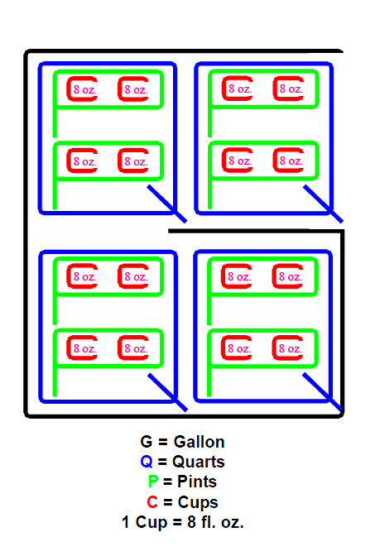

Slide 15
The BIG Inch
0 1
1
16
1
8
3
16
1
4
5
16
3
8
7
16
1
2
9
16
5
8
11
16
3
4
13
16
7
8
15
16
2
2
2
16
2
8
6
16
2
4
10
16
6
8
14
16
4
4
4
16
4
8
12
16
8
8
8
16
16
16
Identity
Property

Slide 16
Comments & Questions?
This presentation and other
resources are available at
www. hisparks.com

