Slide 1
Improving Access to Mathematics:
Strategies for Early Childhood
Presented by
Heather Sparks, NBCT
2009 Oklahoma Teacher of the Year

Slide 2
What makes math difficult?
Lack of prior knowledge
Missing foundational skills
Limited experiences with “doing” math
“One right answer” approach
“Permission” to be “bad” at math
Others?

Slide 3
STRATEGIES:
1. Constant exposure to meaningful math
Every day, provide meaningful math investigations
through manipulatives, games, puzzles, and stories.
Content example: Making Patterns
Roller Derby

Slide 4
Our Winners!
1 | 2 | 3 | 4 | 5 | 6 | 7 | 8 | 9 | 10 | 11 | 12
 | 1+1 | 2+1 | 3+1 | 4+1 | 1+5 | 4+3 | 2+6 | 6+3 | 5+5 | 5+6 | 6+6
 |  | 1+2 | 1+3 | 1 + 4 | 5+1 | 3+4 | 6+2 | 3+6 | 6+4 | 6+5
 |  |  | 2+2 | 3+2 | 2+4 | 5+2 | 5+3 | 4+5 | 4+6
 |  |  |  | 2+3 | 4+2 | 2+5 | 3+5 | 5+4
 |  |  |  |  | 3+3 | 6+1 | 4+4
 |  |  |  |  |  | 1+6

Slide 5
STRATEGIES:
2. Allow students to verbalize their thinking
Every day, expect students to explain their
thinking.
Content example: Counting backwards
Loose caboose

Slide 6
STRATEGIES:
3. Provide for meaningful use of manipulatives
Manipulatives should be available and integrated
into every math lesson.
Content example: Showing half
Snap cube measurement

Slide 7
STRATEGIES:
4. Help students develop
“bridge” tools
Students should be taught specific strategies to
improve memory and understanding.
Content example: Coin Chants
Finger Multiplication

Slide 8
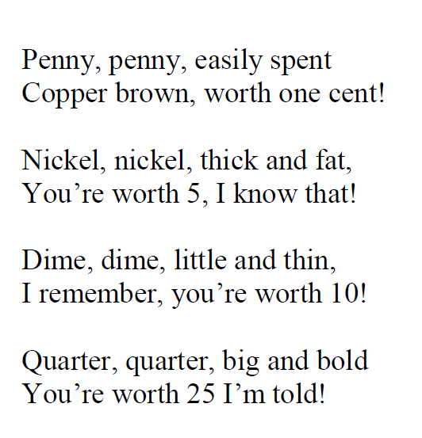

Coin Chants

Slide 9
STRATEGIES:
5. Create “reference” resources
Students should maintain a math journal to record
and store math resources.
Content example: Gallon map
Shape Flip Book

Slide 10
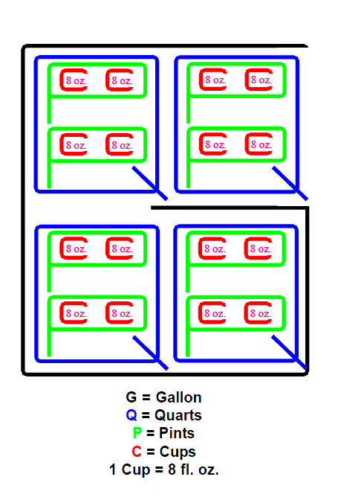

Slide 11
Comments & Questions?
This presentation and other
resources are available at
www. hisparks.com

