Slide 1
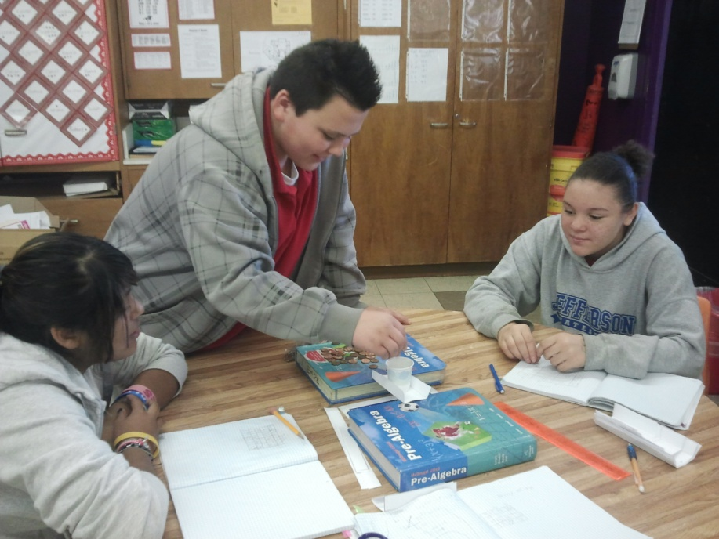
Improving Algebraic Thinking Through
Games and Activities
Heather Sparks, NBCT
Taft Middle School
Oklahoma City Schools
www.hisparks.com
OCTM
June 8, 2012

Slide 2
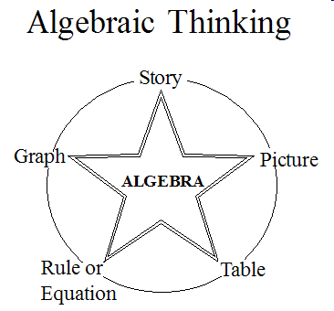
*Adapted from Van de Walle and Lovin

Slide 3
STORY:
Turtle and Snail
On summer day, Little Green Turtle challenged Teeny Tiny Snail to a race from the oak tree to the elm tree.
Turtle travels at a rate of 3 feet per minute and Snail travels at a rate of 2 feet per minute. The trees are 12 feet apart.

Slide 4
PICTURE
Turtle and Snail
12 feet

Slide 5
TABLE
Turtle Snail
time distance
time distance
0
1
2
3
4
0
3
6
9
12
0
1
2
3
4
0
2
4
6
8

Slide 6
RULE OR
EQUATION
Turtle: multiply by 3
Snail: multiply by 2
D=3t
D=2t

Slide 7

GRAPH
12
11
10
9
8
7
6
5
4
3
2
1
0
distance
in feet
0 1 2 3 4 5 6 7 8
time

Slide 8

Given an table, can you create a graph?
x y
0 2
2 6
3 8
5 12
8 18
Can you find the equation?

Slide 9
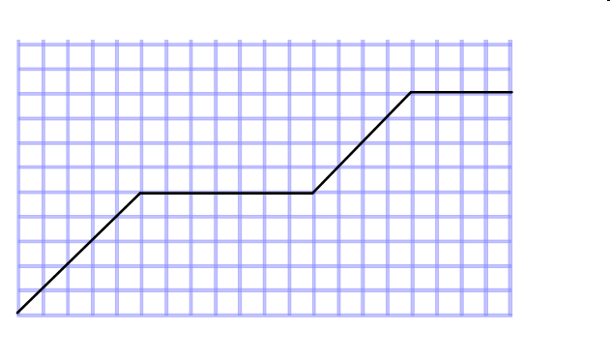
Given a graph, can you write a story?

Slide 10
Let’s Apply!
Penny Bridges
Cup Stacking
Slinky Stretch
Animal Races

Slide 11
Heather’s Contact Information:
hisparks@aol.com
www.hisparks.com

