Slide 1
New Century, New Teacher
ACE/LEAP/FEA
Conference
April 1, 2009
Presented by Heather Sparks, NBCT
2009 Oklahoma Teacher of the Year

Slide 2

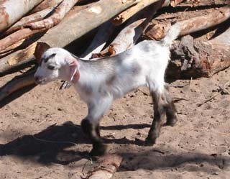
Quick Quiz
Which kid is cuter?
Kid A Kid B

Slide 3
So Why Teach?
Teaching keeps you young.
Teaching is entertaining.
Teaching is a profession.
Teaching enables you to make a difference.
Teaching is always evolving and improving.

Slide 4

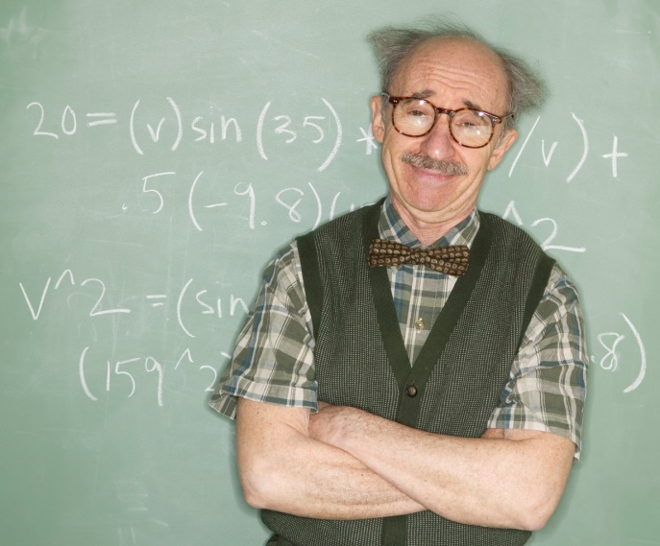
Teaching keeps you young.
How old is this teacher?
56 years young!
83 years young!

Slide 5
Teaching is entertaining.

Slide 6
Teaching is a profession.
Teaching make all other professions possible!
The most respected profession behind nurses and pharmacists!
Numerous professional organizations to join!
National Board for Professional Teaching Standards

Slide 7

Teaching enables you to make a difference.

Slide 8



Teaching is always evolving and improving.
Pod-casting
voiceThread

Slide 9


Slide 10
It means…
New century…new teacher!
We look forward to welcoming
you into the profession!

