Slide 1
New Century, New Teacher
SOEA State Conference
March 7, 2010
Presented by Heather Sparks, NBCT
2009 Oklahoma Teacher of the Year

Slide 2
Think of a time when you were engaged in school.
Describe your experience to someone sitting next to you.

Slide 3
Let’s Describe a…
Student
Learner
  Passive
  Bored
  Told what to think
  Typically unmotivated
  Focused on the grade
  Active
  Engaged
  An independent thinker
  Internally motivated
  Focused on the learning

Slide 4
What is Student Engagement
Student engagement occurs when "students make a psychological investment in learning. They try hard to learn what school offers. They take pride not simply in earning the formal indicators of success (grades), but in understanding the material and incorporating or internalizing it in their lives."[
-Student Engagement and Achievement in American Secondary Schools. Teacher College Press, p. 2-3.

Slide 5
Some Facts About
Student Engagement
Half said their classes were boring.
Two-thirds say they cheated on a test.
90% copied homework from someone else.
80% say it’s not important to get good grades in school.
(Steinberg, 1996)

Slide 6
What can be done?
Research shows that teachers who are most successful in engaging students develop activities that address intellectual and psychological needs including work that:
  Develops their sense of competency;
  Encourages self-expression and originality;
  Allows them to develop connections with other; and
  Gives them some degree of autonomy.

Slide 7
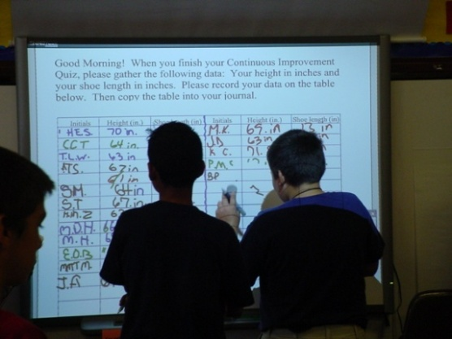
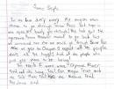
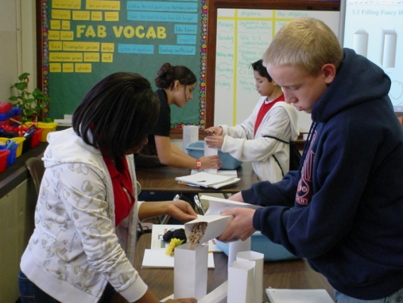
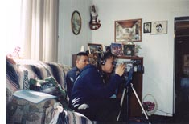

What does this look like?
The “Ultimate” Apartment Project
Survey Monkey Data Project
A Pioneer’s Diary
Kindergarten Pod-casts
Veterans’ Project

Slide 8






The influence of technology…
Pod-casting
voiceThread

Slide 9
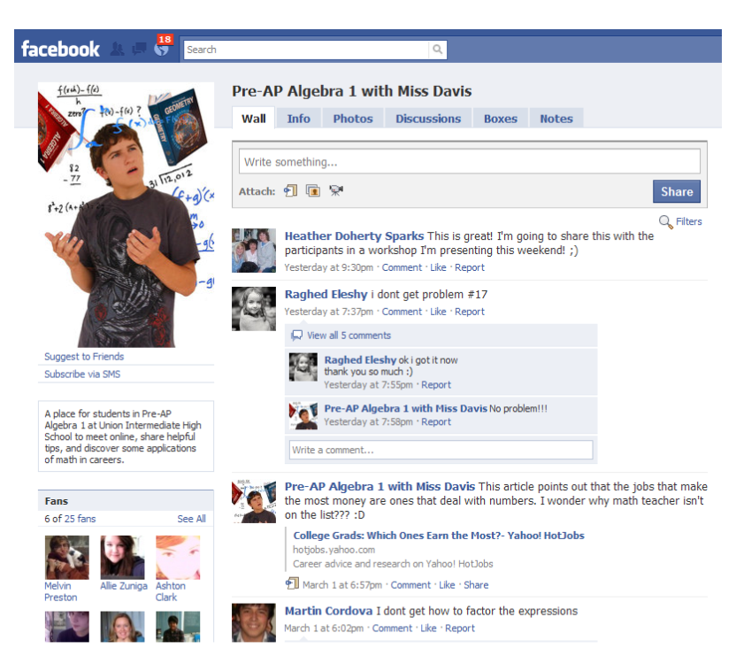
What about a class facebook page?

Slide 10
Grab a partner…
Choose one technology with which you are familiar.
Brainstorm a lesson that could be taught integrating this technology.
Be sure to keep student engagement at the center of your lesson!

Slide 11
Did_You_Know__4_0

Slide 12
It means…
New century…new teacher!
We look forward to welcoming
you into the profession!

Slide 13
For a Copy of this Presentation, visit Heather’s Website:
www.hisparks.com
Click on ‘Presentations’

