Slide 1
Improving Student Engagement
Developing A Rigorous Curriculum for the 21st Century
Presented by Heather Sparks, NBCT
2009 Oklahoma Teacher of the Year

Slide 2
Some Facts About
Student Engagement
Over one-third of students do not take school seriously and get through the day by fooling around with classmates.
Half said their classes were boring.
Two-thirds say they cheated on a test.
90% copied homework from someone else.
80% say it’s not important to get good grades in school.
20% say disengagement is a result of confusion or difficulty of subject matter, particularly in math and science.
(Steinberg, 1996)

Slide 3
Think of a disengaged student from your experience…
Why is this student disengaged?
  Lack of challenge (too easy)
  Lack of success (too hard)
  Lack of relevance (can’t see the point)
  Lack of relationships (don’t care about the people)
  Lack of value in what is being learned (don’t care about the information)
  Other factors interfering (e.g., safety, hunger, lack of sleep)

Slide 4
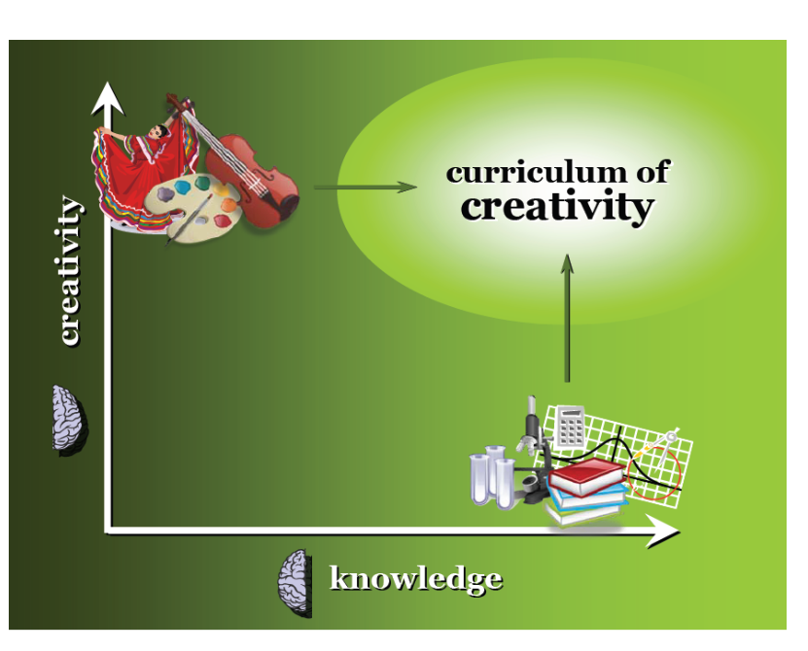
How did this happen?

Slide 5
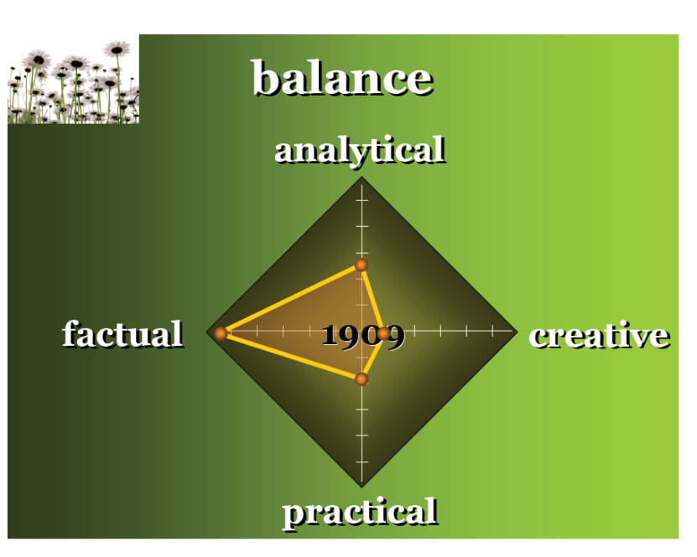

Slide 6
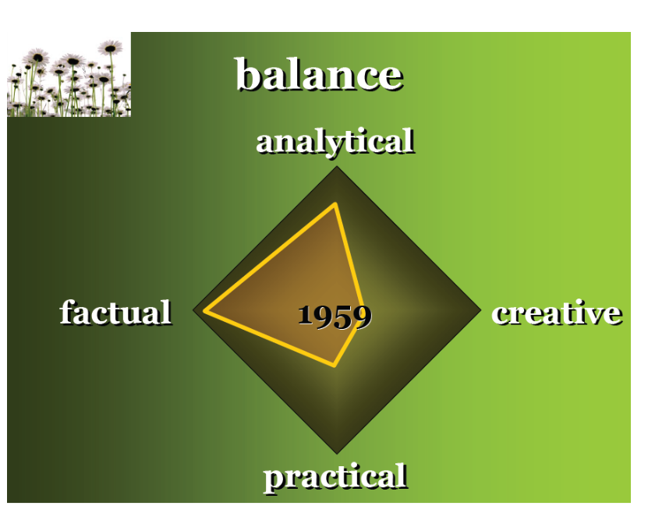

Slide 7
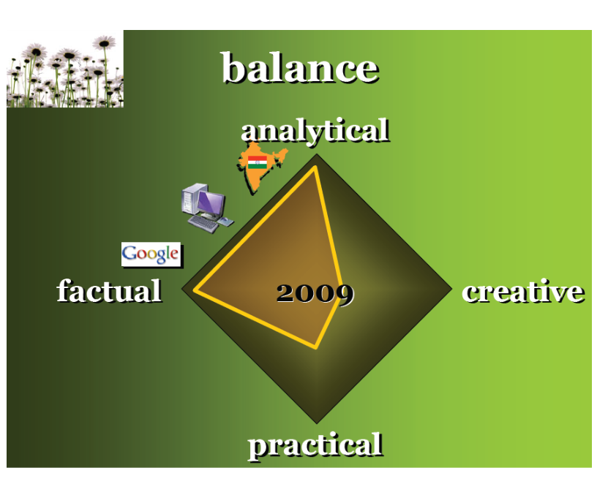

Slide 8
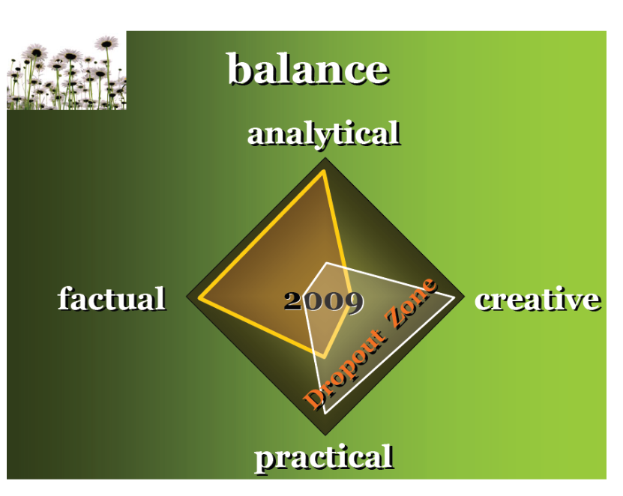

Slide 9
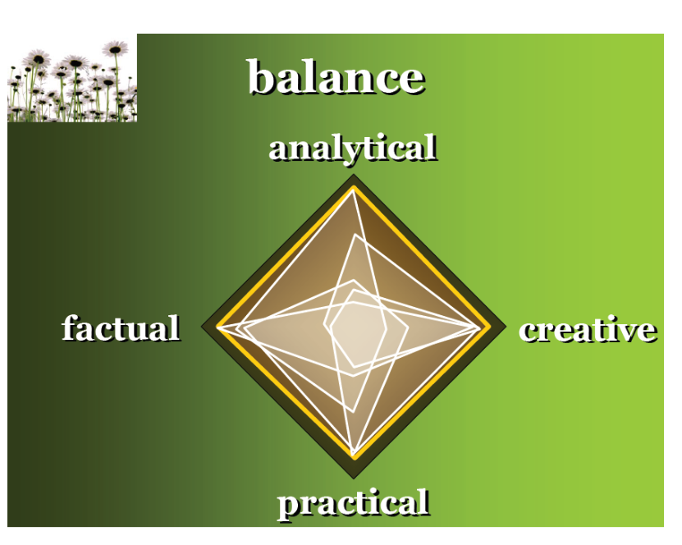

Slide 10
What can be done?
Ames, Strong, et. al., and Anderman and Midgely, show that teachers who are most successful in engaging students develop activities that address intellectual and psychological needs including work that:
  Develops their sense of competency;
  Encourages self-expression and originality;
  Allows them to develop connections with other; and
  Gives them some degree of autonomy.

Slide 11
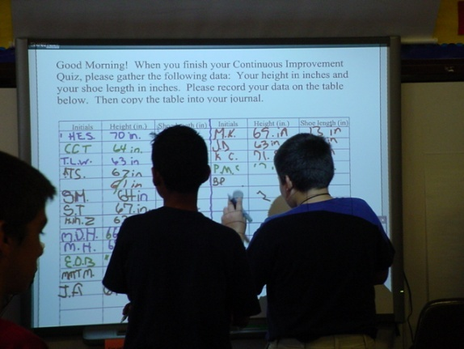
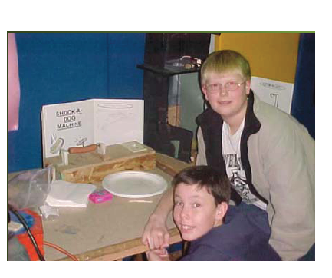
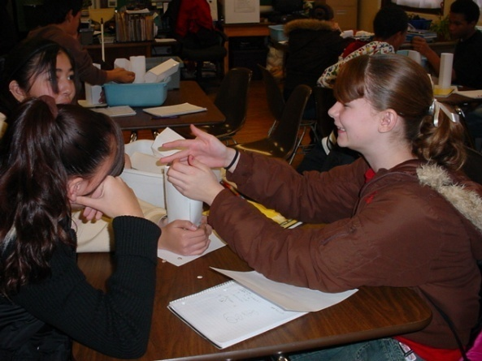
What does this look like?
The “Ultimate” Apartment Project
Night of the Electric Creation
“Me”suems
A Pioneer’s Diary
Kindergarten Pod-casts
Veterans’ Project
Geometry on the Playground

Slide 12

Why does it matter?

Slide 13
Now you know…

Slide 14
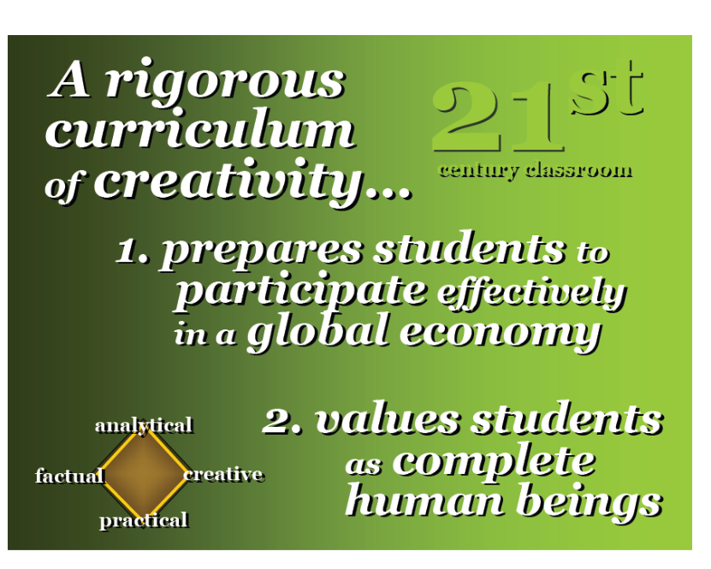

Slide 15
For a Copy of this Presentation, visit Heather’s Website:
www.hisparks.com
Click on presentations.
Would you like Heather to visit your school?
Call 405-850-9074

